Slide 1


CYCLISTIC BIKE SHARE DATA ANALYSIS
Aritra Basu
10/04/2023
Dataset Source:
Click Here

Slide 2

BUSINESS QUESTION
How do Annual Members and Casual Riders use Cyclistic bikes differently?

Slide 3

OUTLINE
Executive Summary
Introduction
Methodology
Results
Visualizations – Charts
Findings
Dashboard
Conclusion
Appendix

Slide 4

EXECUTIVE SUMMARY
Contextualization of data and the goal of the analysis
Methodology Description
Capturing Yearly Usage of Bike Share Service For 2022
Average Minutes spend by weekly, monthly , and quarterly
Percentage of Annual Members and Casual Riders
Percentage of service used by Annual Members and Casual Riders
Classification on dataset in terms of Usage
Annual Members
Casual Riders

Slide 5

INTRODUCTION
Cyclistic Bike Share Data is a hypothetical dataset which contains data about ride sharing of the organization
The data collected represent all of the people (Annual Members / Casual Riders) who used the service during 2022
Analyzing the current usages and trends in terms of services taken from Jan 2022 to Dec 2022
Purpose of Analysis
Analyzing usage of the services weekly, monthly, and quarterly
Determining the usage analytics of bike ride service
Target Audience
Marketing Managers
Operations Department

Slide 6

METHODOLOGY
DATA COLLECTION
Cyclistic Bike Share 2022 (January to December)
Collecting and Merging Datasets
DATA EXPLORATION
Seeing Trends Through Data
EXPLORATORY DATA ANALYSIS(EDA)
Basic Statistical Analysis
Data Distribution
Finding Outliers
DATA VISUALIZATION
Descriptive Analysis
Tableau Desktop
DATA PRESENTATION
Microsoft PowerPoint

Slide 7
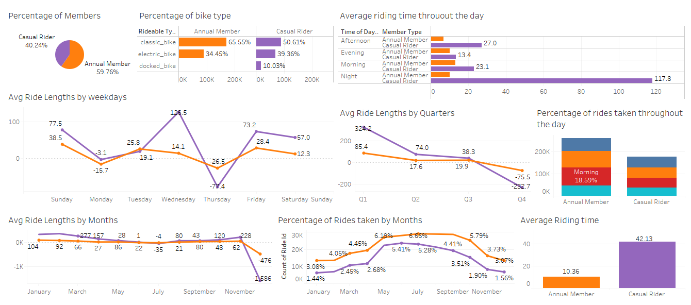
RESULTS

Slide 8

DASHBOARD
THE PERMANENT LINK OF THE READ-ONLY VIEW OF THE TABLEAU DASHBOARD
CLICK HERE

Slide 9
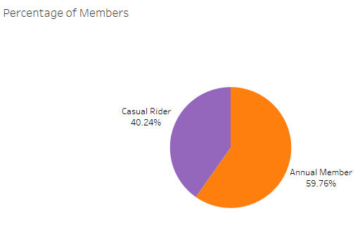
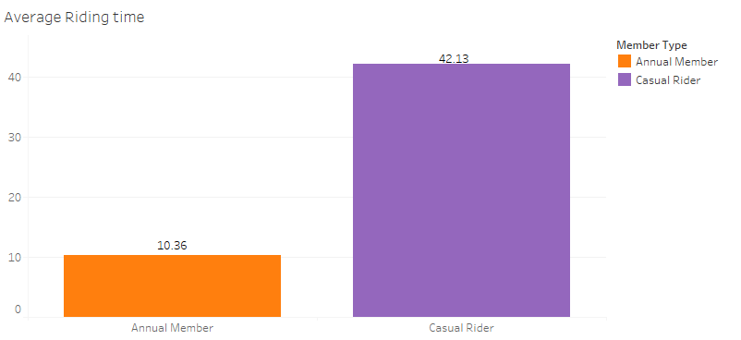
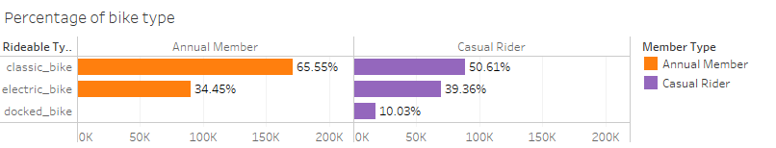
RIDERS AND RIDE TYPES BY CATEGORY

Slide 10
RIDERS AND RIDE TYPES BY CATEGORY-FINDINGS
During 2022, there were 40.24% of casual riders. However in that same span of time we had 59.76% of annual members using our service
During the year 2022 the average ride duration of annual members was 10.36 minutes and for casual riders it was 42.13 minutes
In the same year, the annual members used two types of bikes i.e. classic bikes and electric bikes in which classic bikes were used by 65.55%
The casual riders used three types of bikes i.e. classic bikes, electric bikes, and docked bikes in which classic bikes were used most by 50.61%

Slide 11
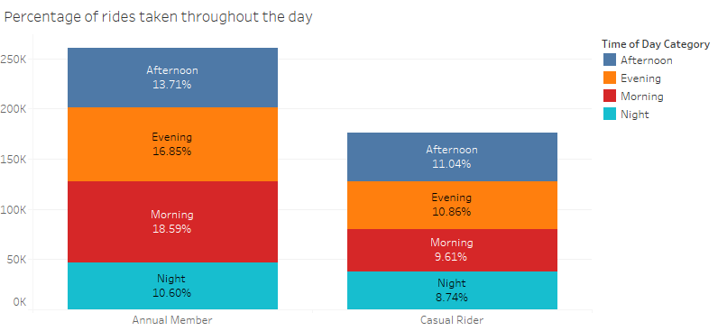
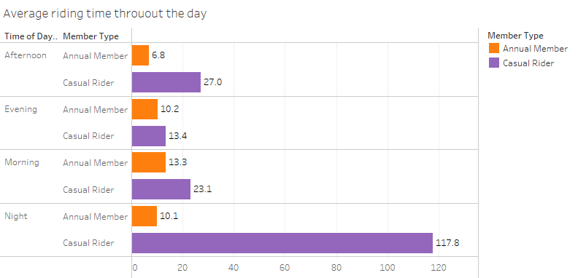
RIDE ACTIVITY THROUGH OUT THE DAY

Slide 12
RIDE ACTIVITY THROUGH OUT THE DAY- FINDINGS
In the morning, 18.59% of the annual members took rides that was highest through out the day and 10.60% at night which was the lowest
The casual riders has the highest percentage of 11.04% rides taken in the afternoon and 8.74% was taken during night
The annual members spent an average time of 13.3 minutes in the morning that is the most and 6.8 minutes in the afternoon that is the least time spend during a day
During a day, the casual riders spent 117.8 minutes on average at night that is the most and 13.4 minutes in the evening that is the least during a day

Slide 13
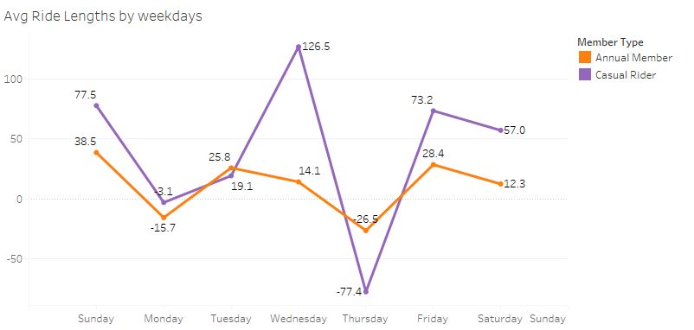
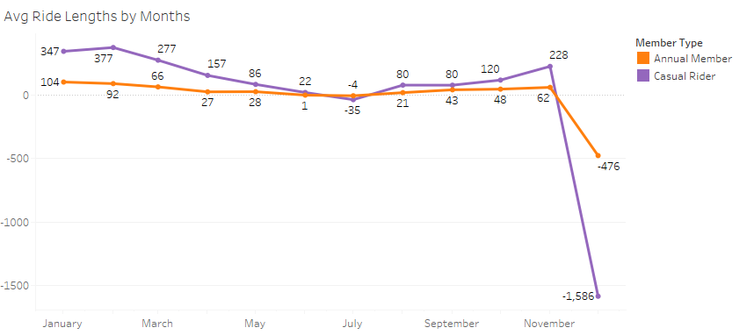
LENGTH OF RIDES WEEKLY AND MONTHLY

Slide 14
LENGTH OF RIDES WEEKLY AND MONTHLY- FINDINGS
Annual members spent most times on Sundays on an average of 38.5 minutes and -26.5 minutes on Thursdays that is the least time spent
Casual riders spent on an average of 126.5 minutes on Wednesdays that is the highest and -77.4 minutes on Thursdays in terms of time spent on rides
Annual members spent on an average of 104 minutes in the month of January as the most and -476 minutes in December as the least on rides
Casual riders spent an average of 377 minutes in February as the most and -1,586 minutes as the least time in the month of December

Slide 15
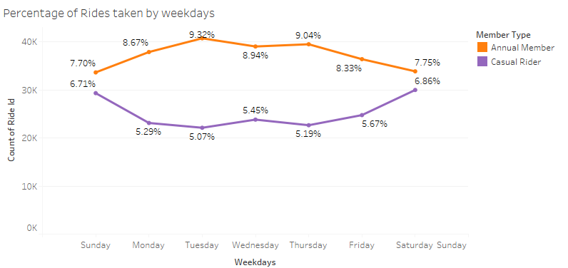
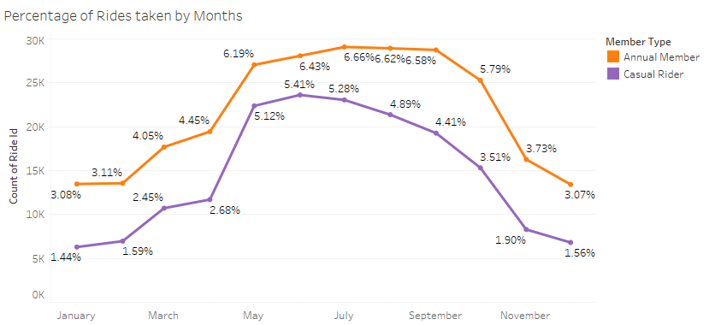
RIDES TAKEN WEEKLY AND MONTHLY

Slide 16
RIDES TAKEN WEEKLY AND MONTHLY- FINDINGS
9.32% of annual members took rides on Tuesdays which is the most and 7.70% of them took rides on Sundays which is the least
Casual riders took rides most on Saturdays that was 6.86% and took least rides on Tuesdays which was 5.07%
Annual Members used bike rides most in the month of July which was 6.66% and the least was taken in the month of December which was 3.07%
Casual rides used bikes the most in the month of June that was 5.41% and the least was of 1.44% in January

Slide 17
CONCLUSION
In 2022, 59.76% riders were annual members
The average ride time of casual riders was 42.13 which was way more than annual members
Classic bikes was the most chosen between both annual members and casual riders while docked bikes was used by only casual riders
Morning was the time when most of the annual members took ride, and on the other hand casual riders took ride most in afternoon
Annual members spent most time in the morning, on Sundays and in January
Casual riders spent most time at night, on Wednesdays and in February
Annual members took most rides on Tuesdays and in July whereas casual riders took most rides on Saturdays and in June

Slide 18

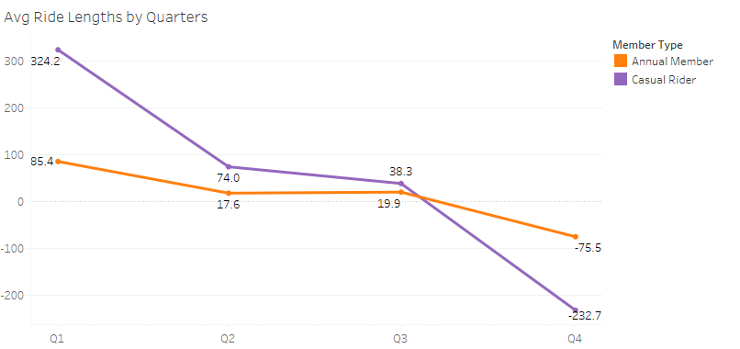
APPENDIX
LENGTH OF RIDES QUARTERLY

Slide 19
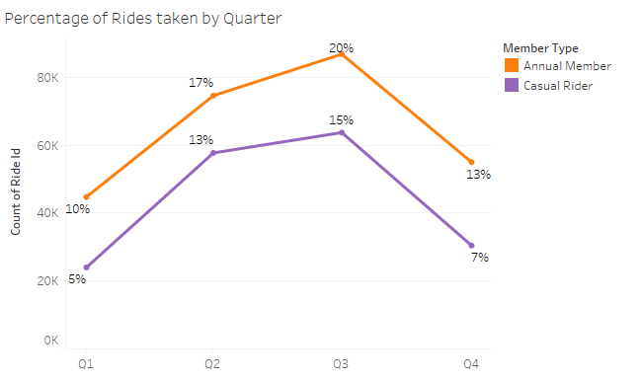
PERCENTAGE OF RIDES TAKEN QUARTERLY

